Slide 1

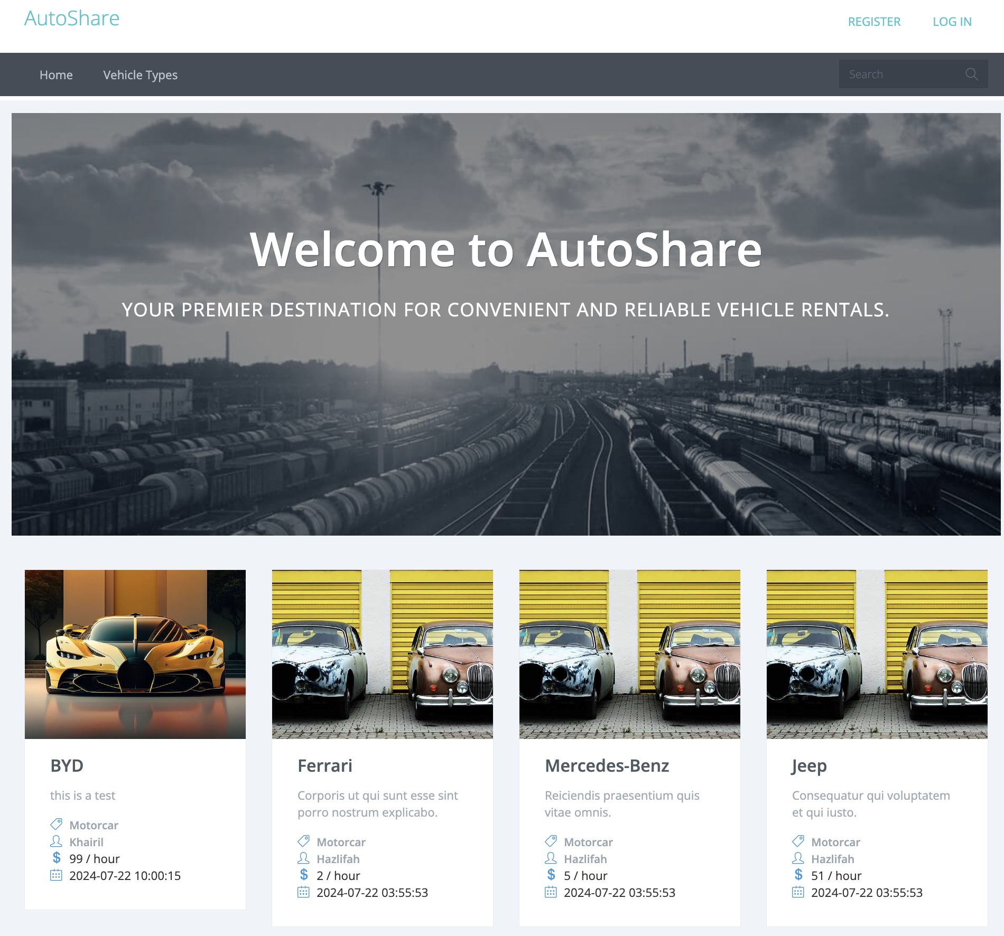
AutoShare
AutoShare is a Laravel application that aims to streamline the vehicle rental process for both owners and customers.
by Roy

Slide 2
Introduction
1
The limitations of rentARide.com
Static website requiring manual updates
Owners had to email administrators to post or modify listings
No user accounts or self-service options for owners
Limited filtering capabilities for customers
2
Key Features of AutoShare
Owners can register, log in, log out, create, update and delete postings (vehicle description and picture).
Customers can view item listings according to the latest posting, owner, or vehicle type.
1

Slide 3
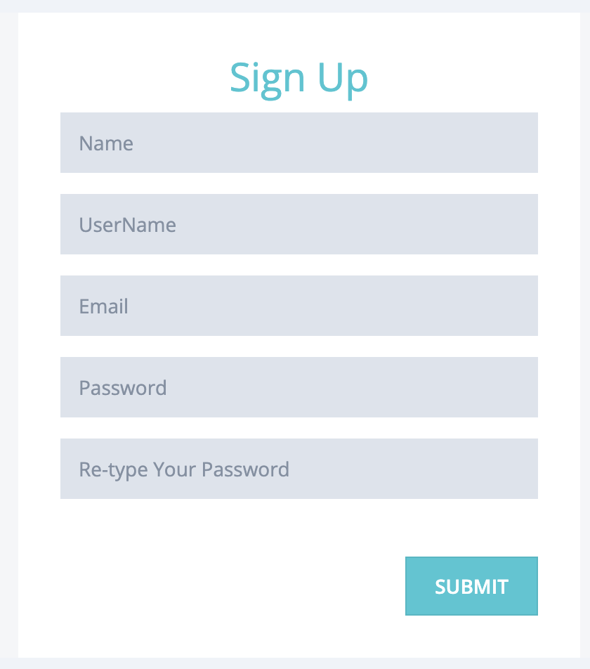
Simplified User Registration
Streamlined Process
The registration process for vehicle owners is straightforward and intuitive, allowing them to quickly set up their profiles.
2

Slide 4
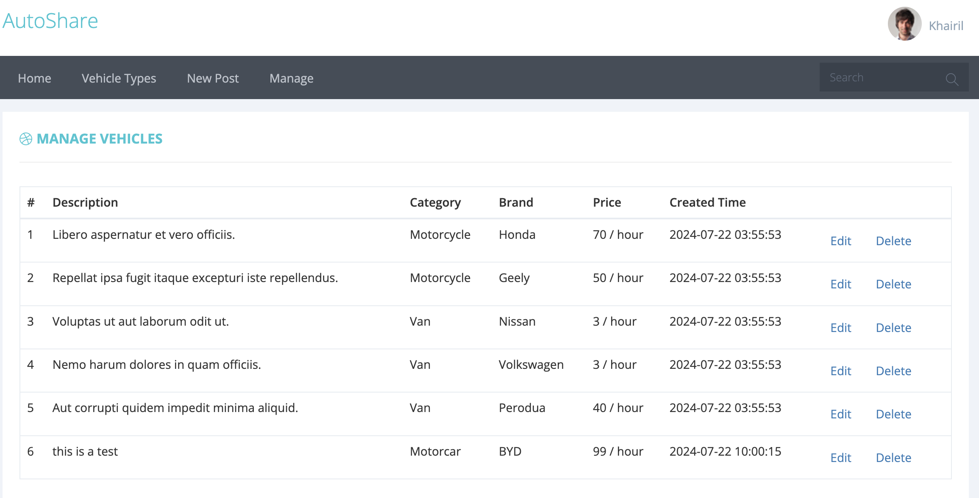
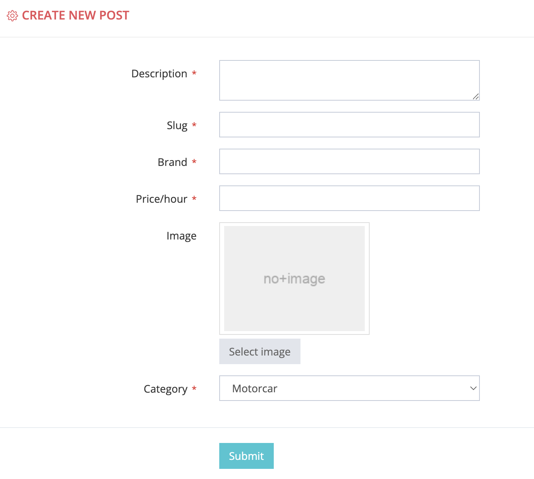
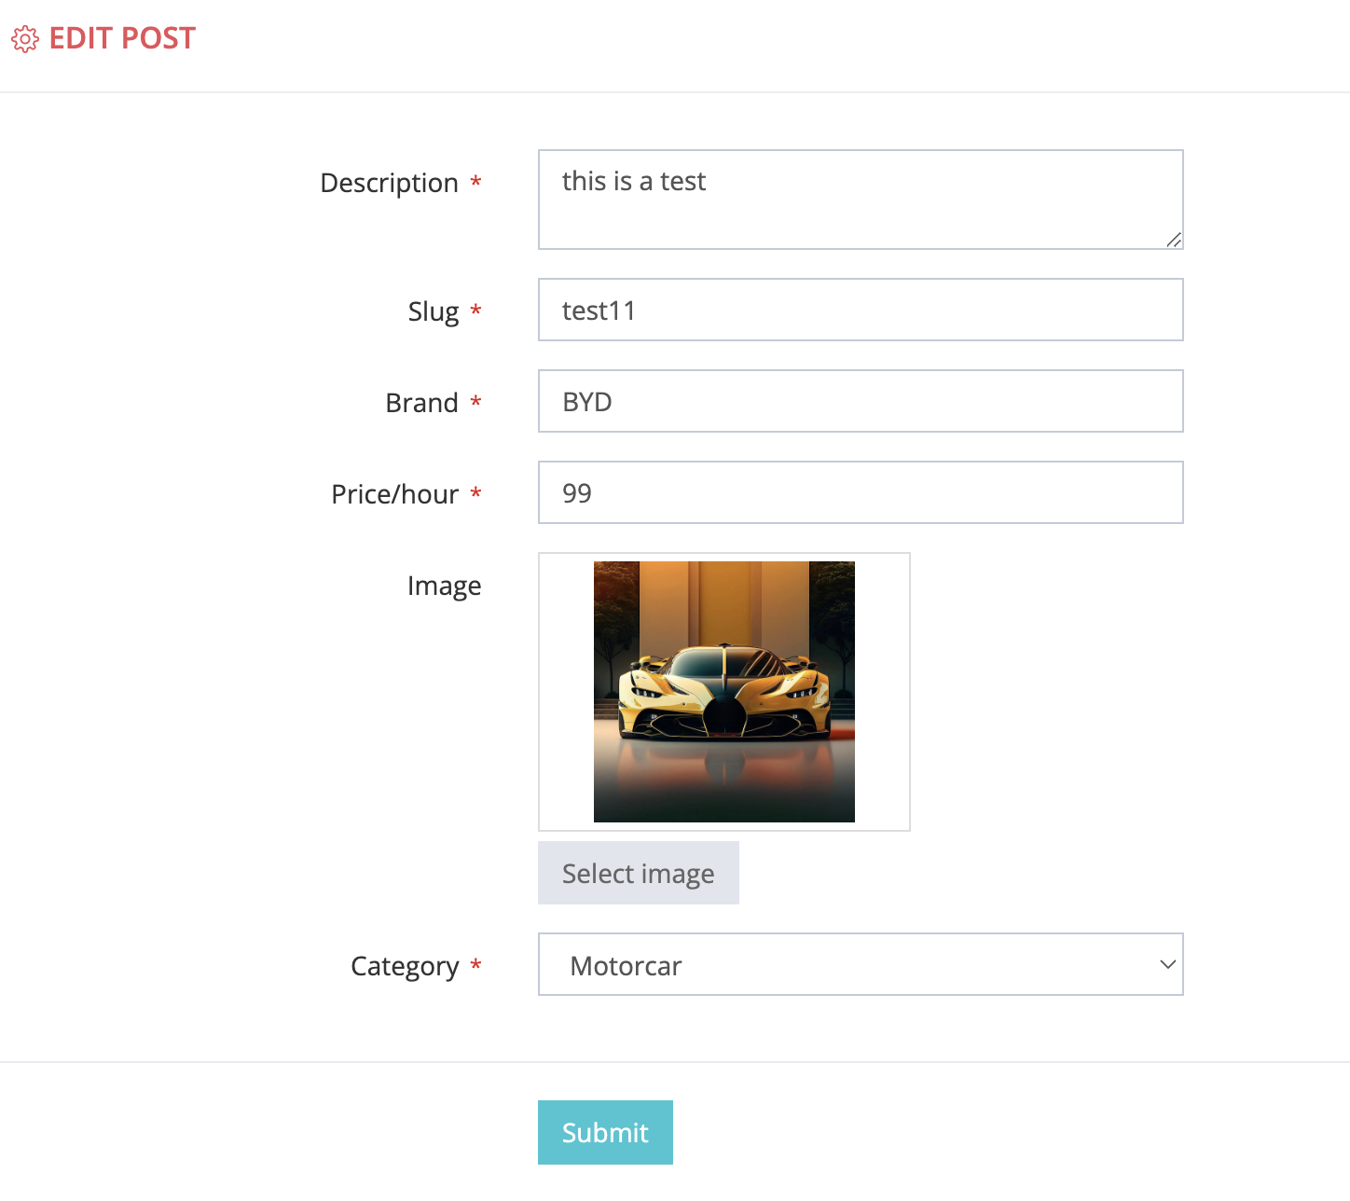
Posting Management
Posting New Rentals
Vehicle owners can easily post their available cars, motorcycles, or other vehicles for rent, including detailed information and images.
Updating Listings
Owners have the flexibility to edit, update and delete their vehicle details, ensuring renters always have access to the most current information.
Visual Presentation
The application integrates vehicle images into the rental postings, providing a visually appealing and informative experience for customers.
3

Slide 5
Enhancing User Experience
in Viewing Rentals
Accessible Listings
Advanced Filtering
Customers can browse the latest vehicle rental postings without the need to log in, making the search process more convenient.
Users can apply filters to explore rentals based on vehicle type, newest postings, and owner details, streamlining their search.
4

Slide 6
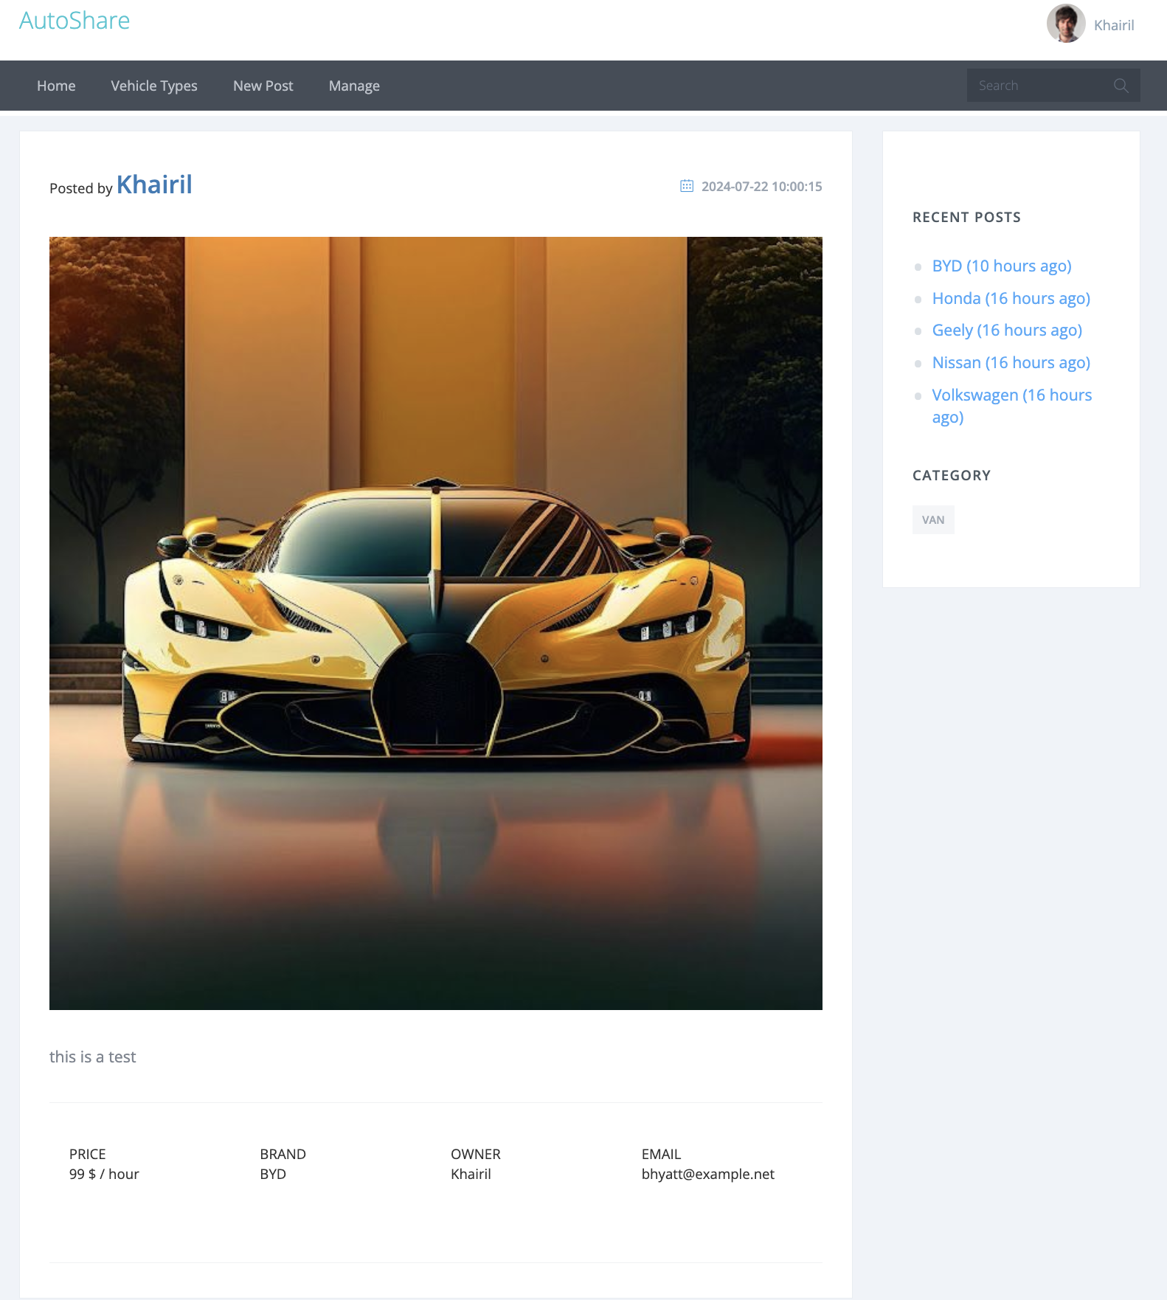
Enhancing User Experience
in Viewing Rentals
Detailed information
Customers can view detailed information about a specific vehicle, including its price, brand, owner, and contact email.
5

Slide 7

System Architecture
Frontend
Image Storage
Utilizes Blade for dynamic rendering, Bootstrap for responsive design, and JavaScript for interactive functionalities.
Uses Local Storage to store uploaded images.
1
2
3
4
Backend
Middleware
Uses PHP Laravel for application logic, MySQL for data storage, and Redis for caching to enhance performance.
Apache serves as the HTTP server, managing secure data exchanges and efficient request handling.
6

Slide 8
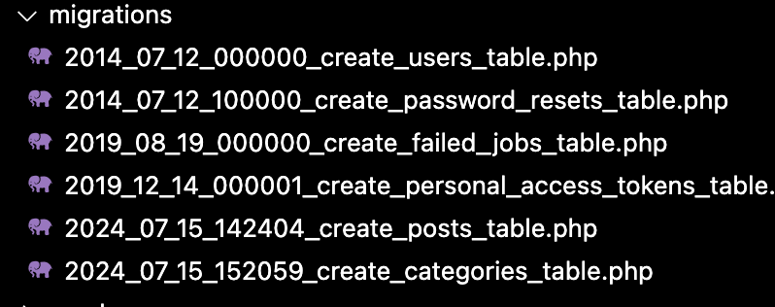
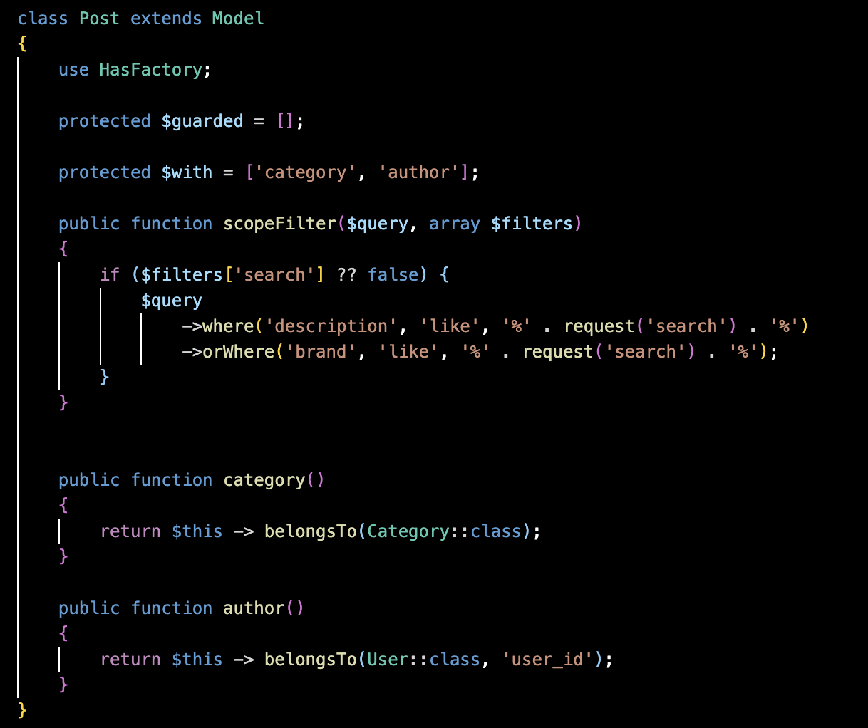
Database Design
Table Structures
The application utilizes Laravel migrations to define the structure of the database tables, ensuring a scalable and adaptable data model.
Eloquent Models
Eloquent, Laravel's powerful ORM, is used to manage the database tables efficiently, simplifying data manipulation and querying.
7

Slide 9
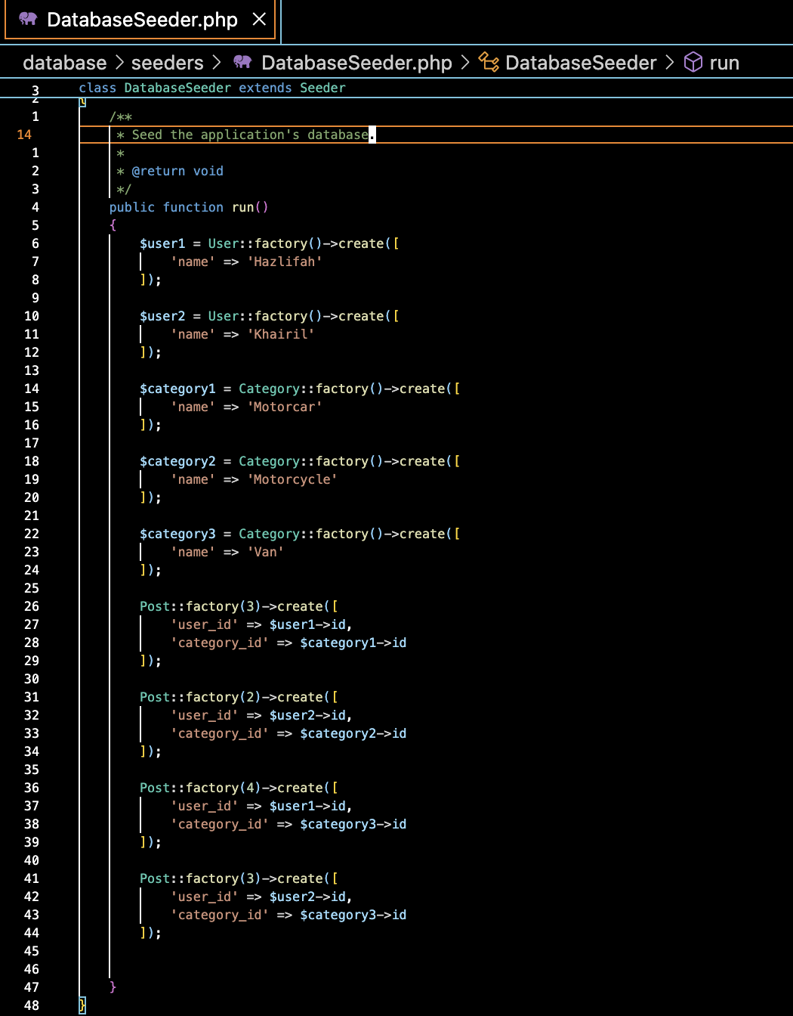



Data Seeding for Testing
Populate Database
Seed files are used to populate the database with initial sample data, facilitating testing and deployment.
Streamlined Testing
The seeded data allows for comprehensive testing of the application's functionality and user experience.
Effortless Deployment
Seed files ensure a smooth initial deployment, providing a ready-to-use dataset for the application.
8

Slide 10




Conclusion and Q&A
Efficiency
User Empowerment
Enhanced Experience
The AutoShare application streamlines the vehicle rental process, providing a more efficient and user-friendly experience.
By giving owners the ability to manage their rentals directly, the application empowers users and fosters a sense of control.
The intuitive interface and intelligent features of AutoShare elevate the overall user experience, setting a new standard in the industry.
9

Slide 11
References
Laravel: "Laravel - The PHP Framework For Web Artisans", Laravel. [Online]. Available: https://laravel.com/docs.
Bootstrap: "Bootstrap Documentation", Bootstrap. [Online]. Available: https://getbootstrap.com/docs.
Blade: "Blade Templates", Laravel. [Online]. Available: https://laravel.com/docs/8.x/blade.
MySQL: "MySQL Documentation", MySQL. [Online]. Available: https://dev.mysql.com/doc/.
Lib Tutorial: "Lib Tutorial", provided by DR HAZLIFAH BINTI MOHD RUSLI (Software Constructions Course). Available: https://elearning.utm.my/23242/course/view.php?id=8485.
10

